Slide 1
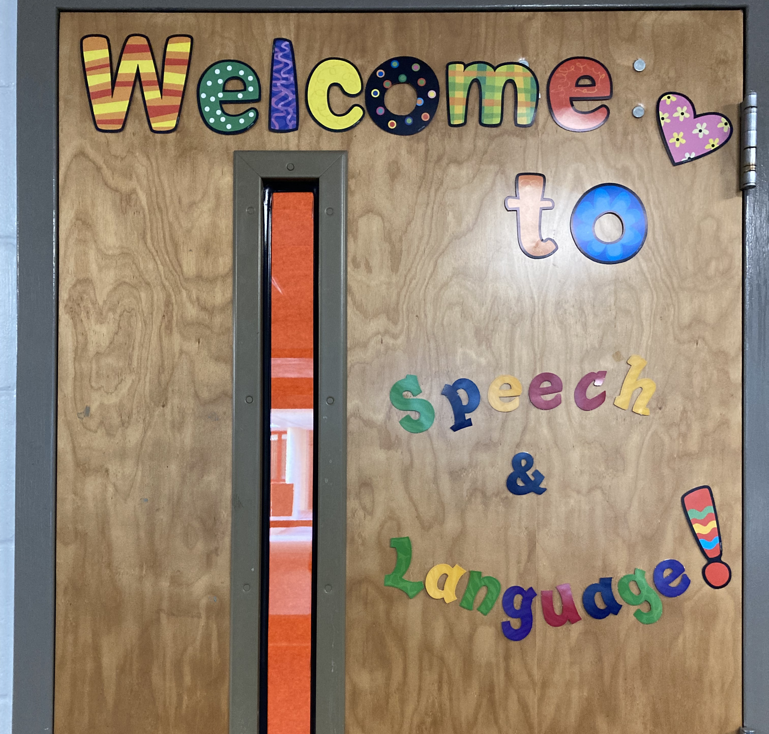
2021-2022

Slide 2
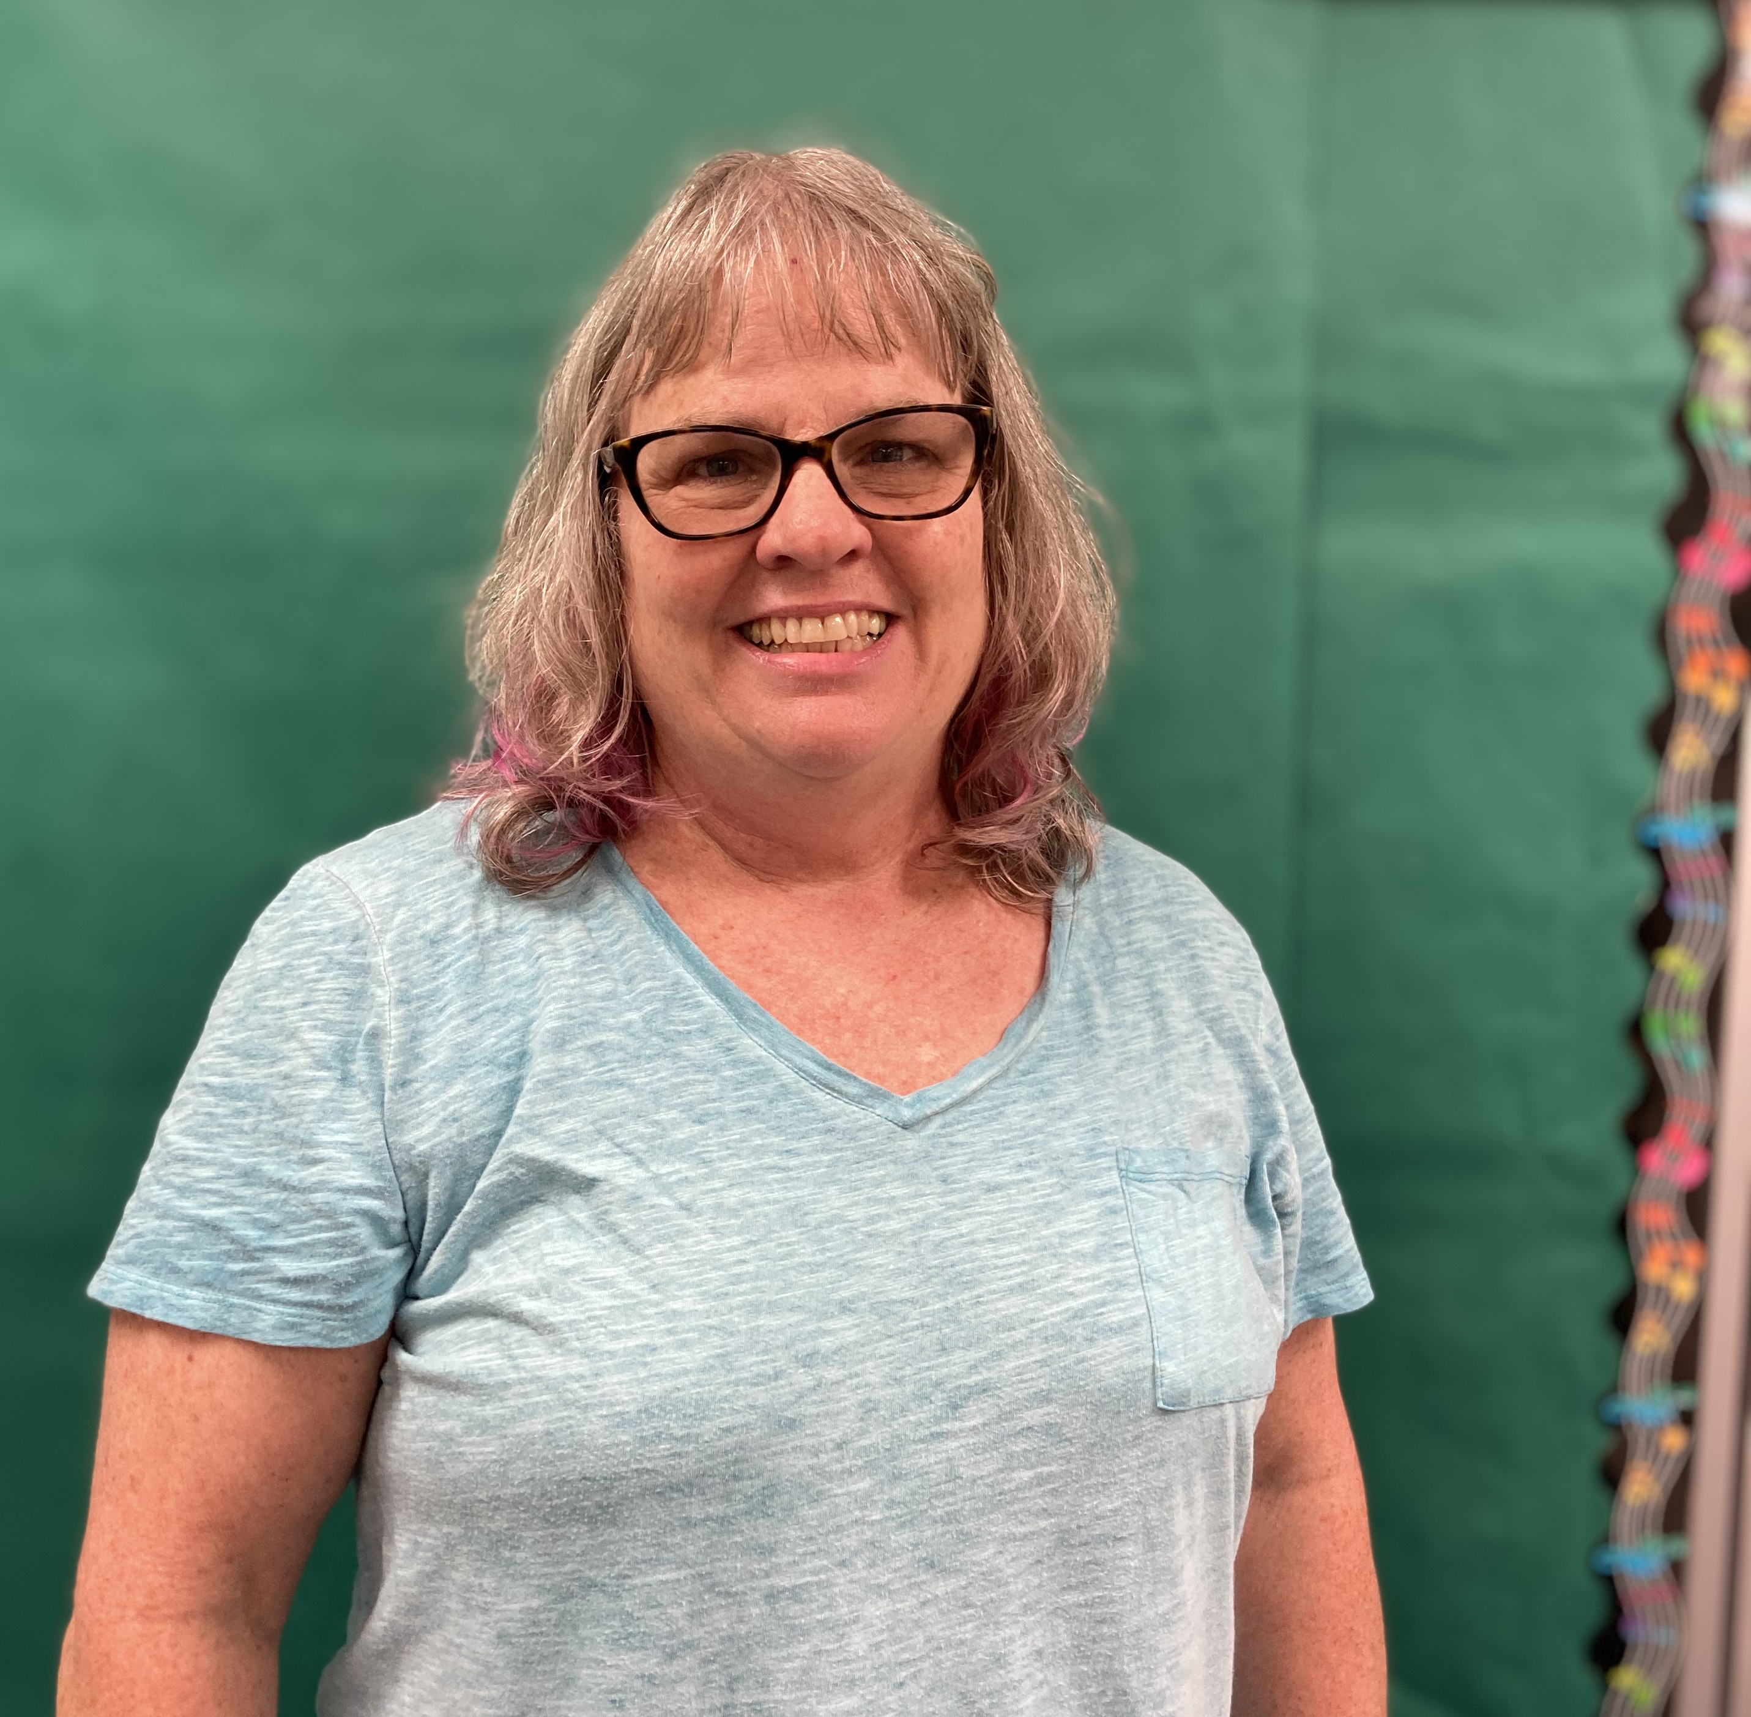
Cathy Nelson
•Mrs. Nelson (Miss Cathy) is in her 27th year as a speech/language pathologist. She has been at Perkins since August, 2007. Mrs. Nelson is married, and is the proud mom of 3 Perkins Alumni! She enjoys kickboxing classes, and playing with her dog, Cady. Mrs. Nelson is primarily serving children in grades K-5.
•If you have any questions about your child’s IEP or the speech and language services being given, please contact her at nelsoncat@pcsb.org or by phone at 893-2117, ext. 1139.

Slide 3
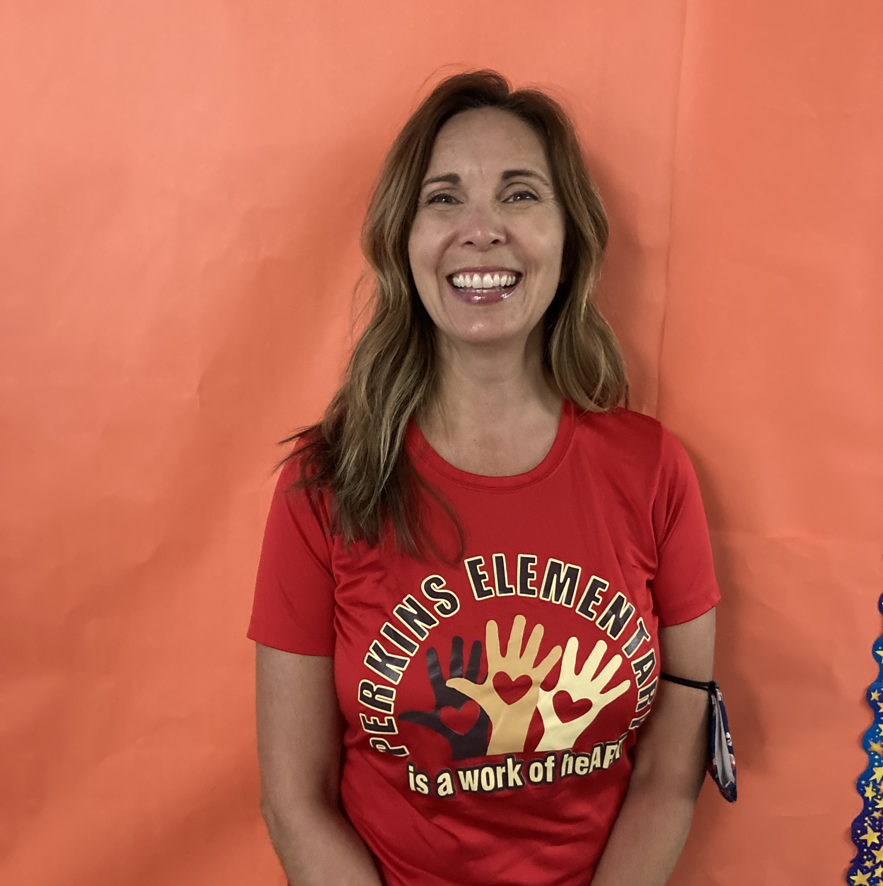
Tracy Coyle
Speech Language Pathologist
Mrs Coyle (Ms. Tracy) as been an SLP for 26 years. She has been working for Pinellas County Schools since 2001, with a back ground in various settings including geriatrics, toddlers 1-3 yrs, in addition to her current itinerant PK-5 position. Mrs. Coyle is married with 2 high school and college age children. She enjoys hiking and walking her dog Sandy.
If you have questions about your child’s IEP services please contact her at coylet@pcsb.org or by phone at (727) 893-2117, ext. 1139.

Slide 4
